Slide 1
Rebuilding Scenarios for Striped Marlin in the Western and Central North Pacific Ocean
Jon Brodziak
Pacific Islands Fisheries Science Center
Email: Jon.Brodziak@NOAA.GOV

Slide 2
Table 1. WCNPO Striped Marlin stock status

Slide 3
Table 2. Stock status

Slide 4
Table 3. Bootstrap distribution of initial population size

Slide 5
Table 4. Recruitment model weights by period

Slide 6
Table 5. Projection recruitment model weights

Slide 7
Table 6. Life history

Slide 8
Table 7.1. Fleet groups

Slide 9
Table 7.2. Fleet groups

Slide 10
Table 8.1. Fleet group harvest by period

Slide 11
Table 8.2. Fleet group harvest by period

Slide 12
Table 6. Rebuilding scenarios

Slide 13
Table 13. Rebuilding probabilities by scenario

Slide 14
Table 14. Overfishing probabilities by scenario

Slide 18
Bootstrap distribution of initial population size

Slide 19
Bootstrap distribution of initial population size

Slide 20
Stock recruitment relationship

Slide 21
Recruitment series

Slide 22
Empirical recruitment models

Slide 24
Change point in recruitment
CP=1993

Slide 25
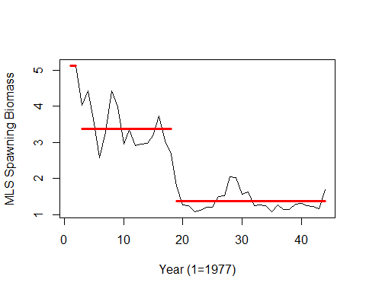
Change point in spawning biomass
CP=1995

Slide 26
5-year recruitment distributions

Slide 27
20-year recruitment distributions

Slide 28
Medium-term recruitment model

Slide 29
Short-term recruitment model

Slide 30
Long-term recruitment model

Slide 31
Recruitment prediction errors

Slide 32
Recruitment model weights

Slide 33
Recruitment model weights

Slide 34
Recruitment model weights

Slide 35
Life history parameters

Slide 36
Life history parameters

Slide 37
Combined-fleet fishery selectivity

Slide 38
Combined-fleet fishery yield per recruit

Slide 39
Combined-fleet spawning biomass per recruit

Slide 40
Combined-fleet spawning potential ratio

Slide 41
Life history parameters

Slide 42
Fishing fleet groups

Slide 43
Fleet groups with dome-shaped selectivity

Slide 44
Fleet groups with flat-topped selectivity

Slide 45
Proportion of fishing mortality by fleet group

Slide 46
Proportion of fishing mortality by fleet group

Slide 47
Catch weights at age by fleet group

Slide 48
Catch weights at age by fleet group

Slide 49
Proportion of catch biomass by fleet group

Slide 50
Proportion of catch biomass by fleet group

Slide 90
Sensitivity run: Medium-term recruitment

Slide 91
Sensitivity run: Short-term recruitment

Slide 92
Sensitivity run: Long-term recruitment

Slide 93
Sensitivity run: Medium-term recruitment

Slide 94
Sensitivity run: Short-term recruitment

Slide 95
Sensitivity run: Long-term recruitment

Slide 96
Sensitivity run: Medium-term recruitment

Slide 97
Sensitivity run: Short-term recruitment

Slide 98
Sensitivity run: Long-term recruitment

